Slide 1
LINEAR REGRESSION

Slide 2

continuous categorical
supervised regression classification
unsupervised dimension reduction clustering

Slide 3
What is the motivation for learning about linear regression?
widely used
runs fast
easy to use (not a lot of tuning required)
highly interpretable
basis for many other methods
Notes:
Parametric relationship

Slide 4
What do the terms in this model mean?
y = β₀ + β ₁x + ε
y = response variable (the one we want to predict)
x = input variable (the one we use to train the model)
β₀ = intercept (where the line crosses the y-axis)
β₁ = regression coefficient (the model parameter)
ε = residual (the error)
Notes:
Error term, disturbance
White noise (usually assumed to follow Gaussian distribution)

Slide 5
What do the terms in this model mean?
y = β₀ + β ₁x + ε
y
∆y
β₁ = ∆ y / ∆ x
∆x
β₀
x
Notes:
Error term, disturbance
White noise (usually assumed to follow Gaussian distribution)

Slide 6
multiple linear regression model
We can extend this model to several input variables, giving us the multiple linear regression model:
y = β₀ + β ₁x₁ + … + β _{n}x_{n} + ε

Slide 7
ESTIMATING COEFFICIENTS
How to determine the impact of a particular input variable on the response variable?
The coefficient estimates
Notes:
Error term, disturbance
White noise (usually assumed to follow Gaussian distribution)

Slide 8
ESTIMATING COEFFICIENTS
What is meant by estimates?
We are making an inference based off of a sample.
Estimates
y
True Model
x
A fundamental part of statistics is quantifying our confidence that our estimates are reflective of truth.
Notes:
Error term, disturbance
White noise (usually assumed to follow Gaussian distribution)

Slide 9
ESTIMATING COEFFICIENTS
How to estimate coefficients for a linear model?
By finding the line that minimizes the sum of squared residuals.
y
x
Notes:
Error term, disturbance
White noise (usually assumed to follow Gaussian distribution)

Slide 10
ESTIMATING COEFFICIENTS
Q: How to estimate coefficients for a linear model?
A: By finding the line that minimizes the sum of squared residuals.
y
x
Notes:
Error term, disturbance
White noise (usually assumed to follow Gaussian distribution)

Slide 11
ESTIMATING COEFFICIENTS
How to estimate coefficients for a linear model?
By finding the line that minimizes the sum of squared residuals.
Model Prediction
y
Observed Result
x
Notes:
Error term, disturbance
White noise (usually assumed to follow Gaussian distribution)

Slide 12
ESTIMATING COEFFICIENTS
How to calculate estimates that minimize the sum of squared errors?
Through calculus, it can be shown that the following equation minimizes the sum of squared errors.
Notes:
Error term, disturbance
White noise (usually assumed to follow Gaussian distribution)

Slide 13
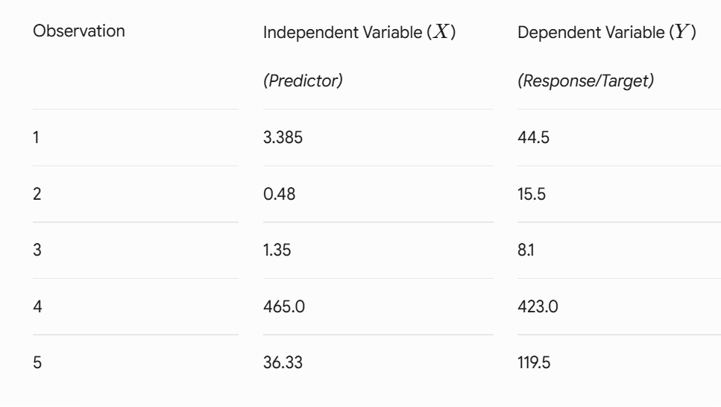
Example of Dataset

Slide 14
ESTIMATING COEFFICIENTS
Let’s walk through an trivial calculation to see how this works.
Predictor column
Response column
“Dummy” column
placeholder for the
error variable β₀
Along the way, we’ll review some matrix math.
Notes:
Error term, disturbance
White noise (usually assumed to follow Gaussian distribution)

Slide 15
ESTIMATING COEFFICIENTS
Transposing simply means flipping the columns and rows
Notes:
Error term, disturbance
White noise (usually assumed to follow Gaussian distribution)

Slide 16
ESTIMATING COEFFICIENTS
Notes:
Error term, disturbance
White noise (usually assumed to follow Gaussian distribution)

Slide 17
ESTIMATING COEFFICIENTS
Only square matrices can be inverted
Taking the inverse of a 2x2 matrix simply means swapping across diagonals, and dividing each value by the determinant.
Notes:
Error term, disturbance
White noise (usually assumed to follow Gaussian distribution)

Slide 18
ESTIMATING COEFFICIENTS
Notes:
Error term, disturbance
White noise (usually assumed to follow Gaussian distribution)

Slide 19
ESTIMATING COEFFICIENTS
Notes:
Error term, disturbance
White noise (usually assumed to follow Gaussian distribution)

Slide 20
CATEGORIAL VARIABLES
How do we deal with categorical variables? (i.e., with k levels)
Major (k=4)
Computer Science
Engineering
Business
Literature
Business
Engineering
Notes:
http://pareonline.net/getvn.asp?v=8&n=2

Slide 21
CATEGORIAL VARIABLES
How do we deal with categorical variables? (i.e., with k levels)
Create a k-1 binary (“dummy”) variables.
Major (k=4)
Computer Science
Engineering
Business
Literature
Business
Engineering
Engineering | Business | Literature
0 | 0 | 0
1 | 0 | 0
0 | 1 | 0
0 | 0 | 1
0 | 1 | 0
1 | 0 | 0
Computer Science is the reference
Notes:
http://pareonline.net/getvn.asp?v=8&n=2

Slide 22
CATEGORIAL VARIABLES
Why k-1 and not k?
Because k-1 captures all possible outputs, and to avoid multicollinearity.
Multicollinearity is when two or more predictor variables in a regression model are very correlated
Notes:
http://pareonline.net/getvn.asp?v=8&n=2

Slide 23
CATEGORIAL VARIABLES
Does it matter which factor level I leave out?
Yes, this is the reference point for all other factor levels.
Notes:
http://pareonline.net/getvn.asp?v=8&n=2

Slide 24
CATEGORIAL VARIABLES
Is this the only way to represent categorical data?
This is the conventional way to represent nominal data, however, ordinal data can be represented with integers.
Categories that can be ranked (i.e., strongly disagree, disagree, neutral, agree, strongly agree) can be represented as 1, 2, 3, 4, 5.
Ordinal meaning that the data have order,
While Nominal data have NO order
Notes:
http://pareonline.net/getvn.asp?v=8&n=2

